Slide 1

SDP Evaluation Grocery Availability Checker and Stock Predictor using Machine Learning Supervised By: Dr. Suprava Devi
Group No.#: J-6
Name of the Student(s) with Regd.
No.:1. Kashish Panda (1941012615)
No.:2. Aryan Prahraj (1941012943)
Department of Computer Sc. and Engineering
Faculty of Engineering & Technology (ITER)
Siksha ‘O’ Anusandhan (Deemed to be) University
Bhubaneswar, Odisha
1

Slide 2
Presentation Outline
Introduction
Motivations
Uniqueness of the work
Literature Survey
Existing System
Problem Identification
Schematic Layout OR Model Diagram
Methods OR Tools OR Algorithms used
Experimentation and Results
System/Model Specifications
Datasets Description (if any)
Parameters used (if any)
Experimental outcomes (Tables and Figures)
Result Analysis and Validation
Conclusion and Future Scope (Key Findings)
Bibliography
2

Slide 3
Introduction
The retail grocery industry plays a crucial role in providing essential goods to consumers, but stock-outs and unpredictable availability of products can cause inconvenience and frustration.
The Grocery Availability Checker and Stock Predictor project aims to address this issue by utilizing machine learning techniques to forecast when specific food items will run out and determine their availability in stores. The system analyzes customer shopping history, needs, and store sales records
By developing an intelligent system, we can improve the shopping experience for consumers, save their time and money, and contribute to sustainable development goals.
This research study focuses on leveraging historical data, regression, and random forest classifier algorithms to build an accurate prediction model.
The application of machine learning in grocery availability prediction is a novel approach that has the potential to revolutionize supply chain management in the retail industry.
3

Slide 4
Motivation
The motivation behind this project stems from the desire to enhance the efficiency of grocery shopping by reducing stock-outs and ensuring the availability of desired products.
Stock-outs not only inconvenience consumers but also lead to lost sales opportunities for retailers and can negatively impact customer loyalty.
By developing a reliable Grocery Availability Checker and Stock Predictor, we aim to optimize the shopping experience for consumers and improve the overall efficiency of the retail supply chain.
This project aligns with the growing demand for data-driven decision-making in various industries and contributes to the advancement of machine learning applications in the retail sector.
Furthermore, the reduction of food waste through improved inventory management supports sustainability efforts and environmental conservation.

Slide 5
Uniqueness of the work
Utilization of AdaBoost classifier for enhanced prediction accuracy.
Integration of K-fold cross-validation technique for robust model evaluation.
Consideration of weather report data to capture the impact of weather conditions.
The system solves the problem of grocery availability from the consumer's perspective

Slide 6
Literature Survey
Authors | Topic | Problem Addressed | Methodology | Benefits
Juan Manuel et al. | Predicting Out-of-Stock Using Machine Learning: An Application in a Retail Packaged Foods Manufacturing Company | The OOS problem in a retail packaged foods manufacturing company. | The first is based on a single Random Forest classifier with balanced data, and the second is an ensemble of six different classification algorithms | Improved supply chain management, reduced costs associated with lost sales due to OOS situations and increased on-shelf availability (+34%).
Concetta Giaconia et al. | Innovative Out-of-Stock Prediction System Based on Data History Knowledge Deep Learning Processing | The proposed system has critical issues regarding the prediction of residual stock at T days, with T > 5, due to the inability to time-correlate historical and visual data with residual product stock in subsequent T days. | The out-of-stock prediction system utilizes deep learning processing techniques, specifically a deep TCNN (Temporal Causal-Convolutional Neural Network) system. RFID Technology for out-of-stock tracking, computer vision techniques to retrieve customer counting in the market store | Improved inventory management, reduced waste, more efficient purchase order definition, and limiting economic damages deriving from out-of-stock events.
Dong Hoang a et al. | Processing "Sorry, the product you ordered is out of stock": Effects of substitution policy in online grocery retailing | Problem addressed: Post-purchase out-of-stock (PP-OOS) situations where products appear to be available at the time of order but become OOS when dispatched. . | Computer-simulated experiments with two representative samples of more than 3,000 UK consumers to test the effectiveness of two substitution policies. | Provides new insights into how retailers can manage PP-OOS situations and improve customer satisfaction and offers a pathway for substitution decisions that most retailers can apply.
Table 1. Literature Survey

Slide 7
Literature Survey contd…
Authors | Topic | Problem Addressed | Methodologies | Benefits
Kyota Higa et al. | Robust Shelf Monitoring Using Supervised Learning for Improving On-Shelf Availability in Retail Stores | The problem addressed is the need to understand changes in products regarding increases/decreases in product amounts on the shelves. | Supervised learning for improving on-shelf availability, robustly monitor shelves in retail stores. Classifies the detected change regions into several classes representing the actual changes on the shelves, by supervised learning using convolutional neural networks. | The benefits include improved on-shelf availability, which is a key factor for improving profits in retail stores.
Annika Altan et al. | Centralized grocery supply chain planning: Improved exception management | The limitations of traditional grocery supply chain planning and exception management. | The approach taken in the paper involves using business intelligence tools and data mining technology. Collaborative Buyer-Managed Forecasting (CBMF) for improving supply chain performance. The methodology is designed to provide out-of-stock forecasts at the store/product level. | Improved exception management, reduced waste in the supply chain, improved planning of promotional activities, and better collaboration with partners.
Nenad Stefanovic et al. | Application of Data Mining for Supply Chain Inventory Forecasting | The problem addressed in the paper is the need for accurate and up-to-date information to make better inventory management decisions. | A two-phase modelling process for inventory forecasting, predictive algorithms such as decision trees and neural networks are used to improve forecasting quality by utilizing the results of the clustering process | The benefit of using data mining technology and business intelligence tools is that it enables companies to make accurate out-of-stock predictions and deliver real-time and valid information to the right users. This can lead to improved inventory management decisions, reduced costs, and increased customer satisfaction.
Table 2. Literature survey contd

Slide 8
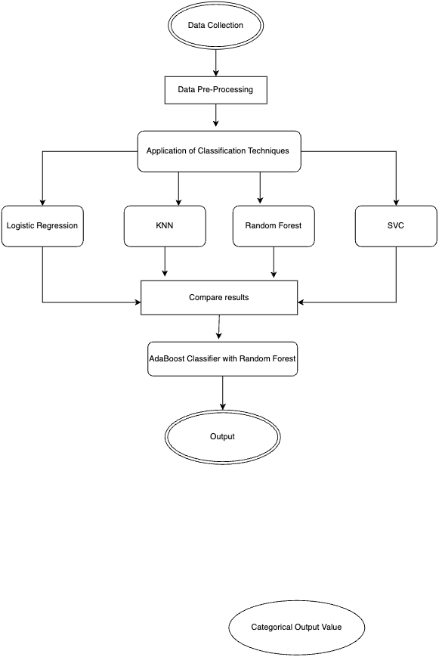
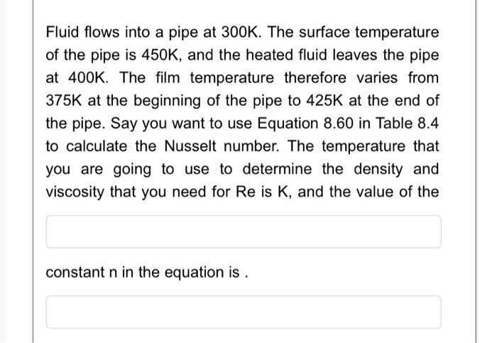

Schematic Layout/Model Diagram
Figure 1. Schematic layout

Slide 9
Tools and Algorithms used
Tools
Software Requirements- Jupyter notebook
Language Requirements- Python
Algorithms
AdaBoost Classifier with random forest
Figure 2. Tools and Algorithm used
9

Slide 10
Experimentation and Results
System Specifications
Hardware Specifications | Software Specifications
Processor : Intel Core i5 RAM : 8 GB Operating System : Windows 10 System type : 64-bit operating system, x64-based processor | Python : 3.6 or higher Jupyter Notebook : Installed using Anaconda distribution Additional python libraries : numpy, pandas, scikit-learn
Table 3. Hardware Specifications
Table 4. Software Specifications

Slide 11
Experimentation and Results Contd..
Datasets Description
Dataset name : Back-order prediction dataset
Dataset source : Kaggle
Dataset size : approx. 8k rows and 17 columns
Dataset Format : CSV
Dataset link : https://www.kaggle.com/datasets/chandanareddy12/back-order-prediction

Slide 12
Experimentation and Results Contd..
Experimental outcomes (Tables and Figures)
 | Accuracy | Precision | Recall | F1-score
KNN | 0.74 | 0.77 | 0.75 | 0.72
SVC | 0.61 | 0.63 | 0.51 | 0.57
Logistic Regression | 0.61 | 0.62 | 0.58 | 0.60
Random Forest | 0.89 | 0.87 | 0.92 | 0.89
Gradient Boosting | 0.87 | 0.85 | 0.88 | 0.87
Adaptive Boosting | 0.85 | 0.83 | 0.87 | 0.85
Adaptive Boosting with Random Forest | 0.92 | 0.87 | 0.92 | 0.90
Adaptive Boosting with Gradient boosting | 0.88 | 0.86 | 0.90 | 0.88
Table 5. Accuracy, Precision, Recall, F1-score table

Slide 13
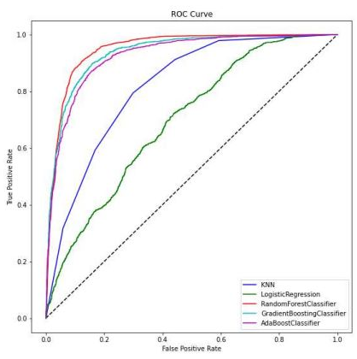
Experimentation and Results Contd..
Experimental outcomes (Tables and Figures) contd...
The figure showcases the ROC curve for different classifiers, including KNN, Logistic Regression, Random Forest classifier, Gradient boosting classifier, and Ada Boost classifier, holds significant importance and impact on your model. The ROC curve is a vital tool for evaluating and comparing the performance of classification models, particularly in terms of their trade-off between true positive rate (sensitivity) and false positive rate (1-specificity). By examining the ROC curve, you can assess the overall predictive power and discrimination ability of each classifier, aiding in the selection of the most suitable algorithm for your specific task. The curve's shape, the area under the curve (AUC), and the classifier's position relative to others provide valuable insights into their performance and assist in optimizing your model's accuracy and reliability.
Figure 3. ROC Curve

Slide 14
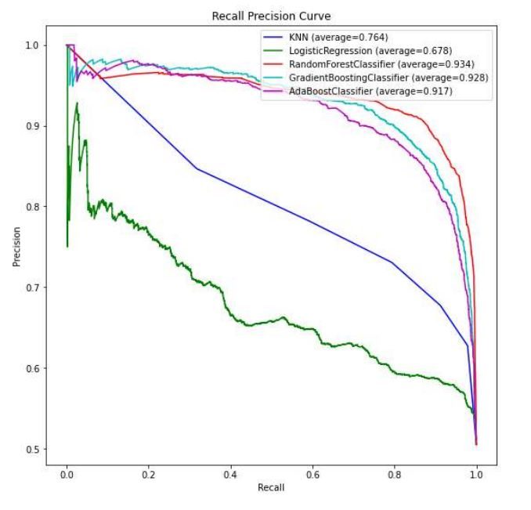
Experimentation and Results Contd..
Experimental outcomes (Tables and Figures) contd...
The figure showcases the Recall-Precision curve for different classifiers, including KNN, Logistic Regression, Random Forest classifier, Gradient boosting classifier, and Ada Boost classifier, holds significant impact, importance, and significance in your model. The Recall-Precision curve provides insights into the trade-off between the recall (true positive rate) and precision (positive predictive value) of each classifier. It helps evaluate their ability to correctly identify positive instances while minimizing false positives. By analysing the curve and comparing the average values, you can assess the overall performance and select the classifier that best balances recall and precision for your specific requirements, thus optimizing the accuracy and reliability of your model.
Figure 4. Recall Precision curve

Slide 15
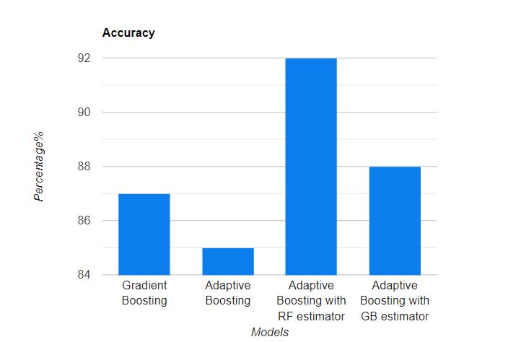
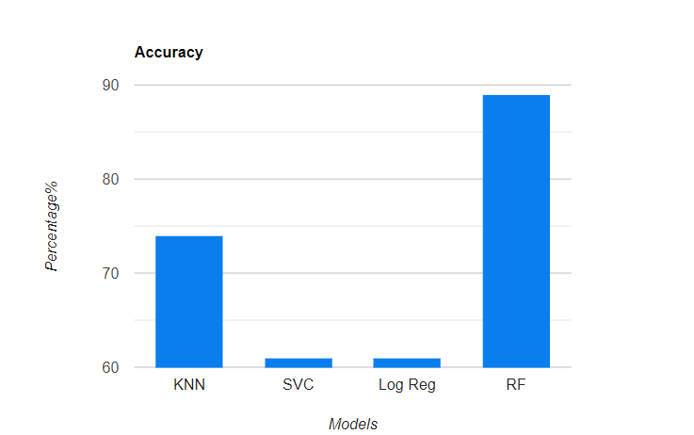
Experimentation and Results Contd..
Result Analysis and Validation
Figure 5. Accuracy comparison of classifier models
Figure 6. Accuracy comparison Of Gradient Boosting Classifier
Random Forest Classifier shows promising results with an accuracy of 89%
Adaptive Boosting with RF estimator shows promising results with an accuracy of 92%

Slide 16
Conclusion and Future Scope (Key Findings)
Conclusion
The Grocery Availability Checker and Stock Predictor project successfully developed a machine learning-based system to estimate and predict the availability of groceries in retail stores.
The system utilized various algorithms and techniques, including AdaBoost classifier, K-fold cross-validation, and weather data integration, to improve prediction accuracy.
The project's results demonstrated the effectiveness of the system in accurately forecasting stock-outs and availability of specific grocery items.
Future Scope
Incorporating real-time data and advanced machine learning algorithms to enhance prediction accuracy and adaptability to changing market conditions.
Expanding the system's capabilities to include additional features such as demand forecasting, price optimization, and personalized recommendations for customers.
16

Slide 17
Bibliography
Andaur, J.M.R.; Ruz, G.A.; Goycoolea, M.(2021), Predicting Out-of-Stock Using Machine Learning: An Application in a Retail Packaged Foods Manufacturing Company. Electronics 2021, 10, 2787.
Giaconia, C.; Chamas, A.(2023) Innovative Out-of-Stock Prediction System Based on Data History Knowledge Deep Learning Processing. Computation 2023, 11, 62.
Dong Hoang, ElsBreugelmans.(2022),“Sorry, the product you ordered is out of stock”: Effects of substitution policy in online grocery retailing,Journal of Retailing, Volume 99, Issue 1,2023,Pages 26-45,ISSN 0022-4359.
Higa, K.; Iwamoto, K.(2019), Robust Shelf Monitoring Using Supervised Learning for Improving On-Shelf Availability in Retail Stores. Sensors 2019, 19, 2722.
Alftan, A., Kaipia, R., Loikkanen, L. and Spens, K. (2015), "Centralised grocery supply chain planning: improved exception management", International Journal of Physical Distribution & Logistics Management, Vol. 45 No. 3, pp. 237-259.
Stefanovic, N., Stefanovic, D., Radenkovic, B. (2008). Application of Data Mining for Supply Chain Inventory Forecasting. In: Ellis, R., Allen, T., Petridis, M. (eds) Applications and Innovations in Intelligent Systems XV.

Slide 18

18

